Slide 1
UCGMI 2022 National Conference
Quest Plus Hotel and resorts
Angeles City, Pampanga, Philippines
June 25-2, 2022

Slide 2
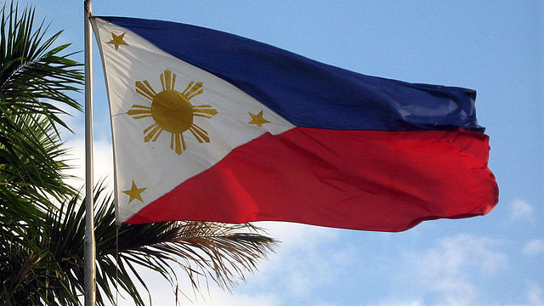
Welcome!
Philippines Leadership Conference!

Slide 3
Recognition and Appreciation
Bishop Randy and Ptra Josie Domis-Ag – National Chairman
Rev. Esmie Taracatac – Damasco – ISABELA District Chairman
Rev. Steve Etrata – PANGASINAN District Chairman
Rev. Bernardo Nilo – LUBE District Chairman
Pastors Lorna Enoch and Mark Taparan – Manila / Cavite District
This Photo by Unknown Author is licensed under CC BY-SA

Slide 4
2019 UCGMI National Conference

Slide 5
Day 1 - accomplishments
2022 UCGMI NATIONAL CONFERENCE

Slide 6
Introductions and Recognition
Pangasinan District
La Union – Benguet District
Isabela District
Manila-Cavite District
United States of America

Slide 7
YOU ARE a Champion!

Slide 8
I FORMED YOU – Jeremiah 1:5
I CALLED you for a PURPOSE – Romans 8:28
I will GIVE you your HEART’s desires – Psalms 37:4
You will SEEK and find…. DOORs will be opened to you – Matthew 7:7
WORK with Faith – James 2:26
Be a VISIONARY – WRITE your VISION – Habakkuk 2:2 / Proverbs 29:18
God will PERFORM through you! – Philippians 1:6
God gave us POWER, LOVE, and SOUND MIND – Philippians 4:6 / 2 Tim. 1:7
God ESTABLISHED and GAVE us the ABILITY to build wealth – Deut. 8:18

Slide 9
Walk, run, and crawl!

Slide 10
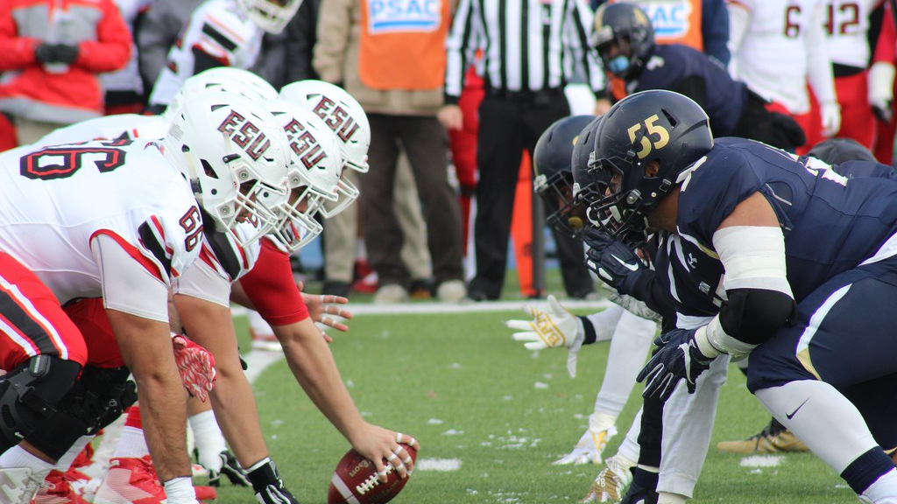
This Photo by Unknown Author is licensed under CC BY

Slide 11
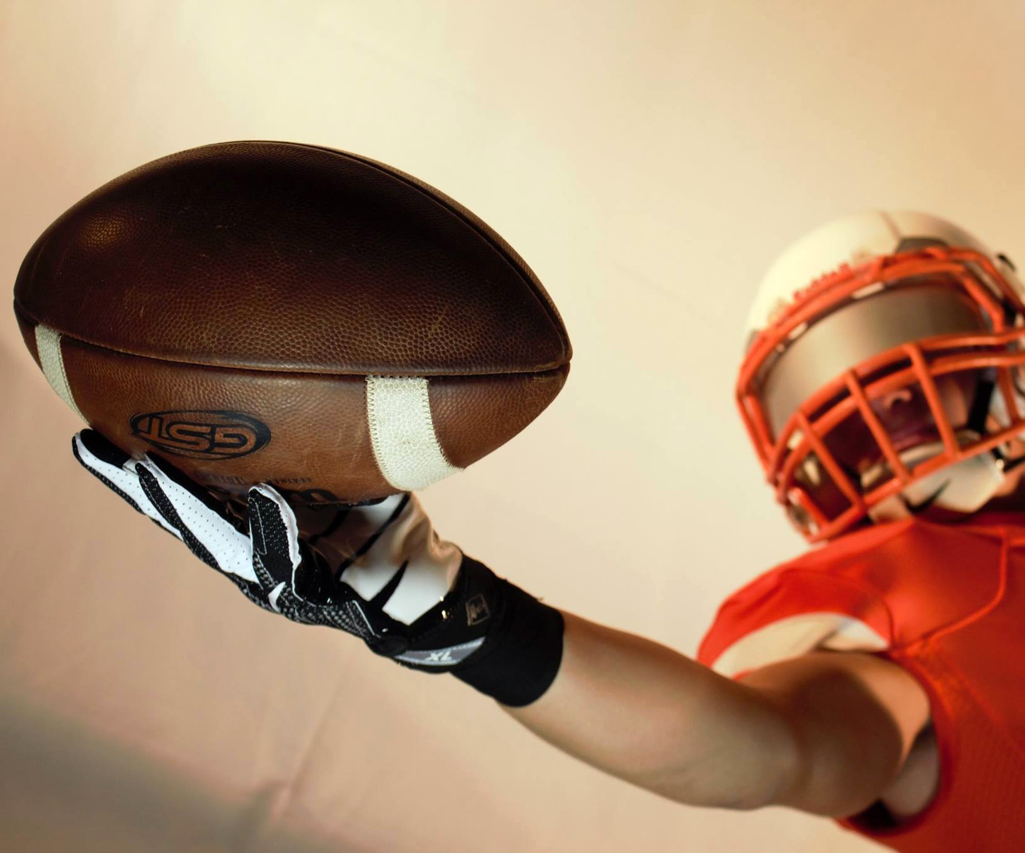
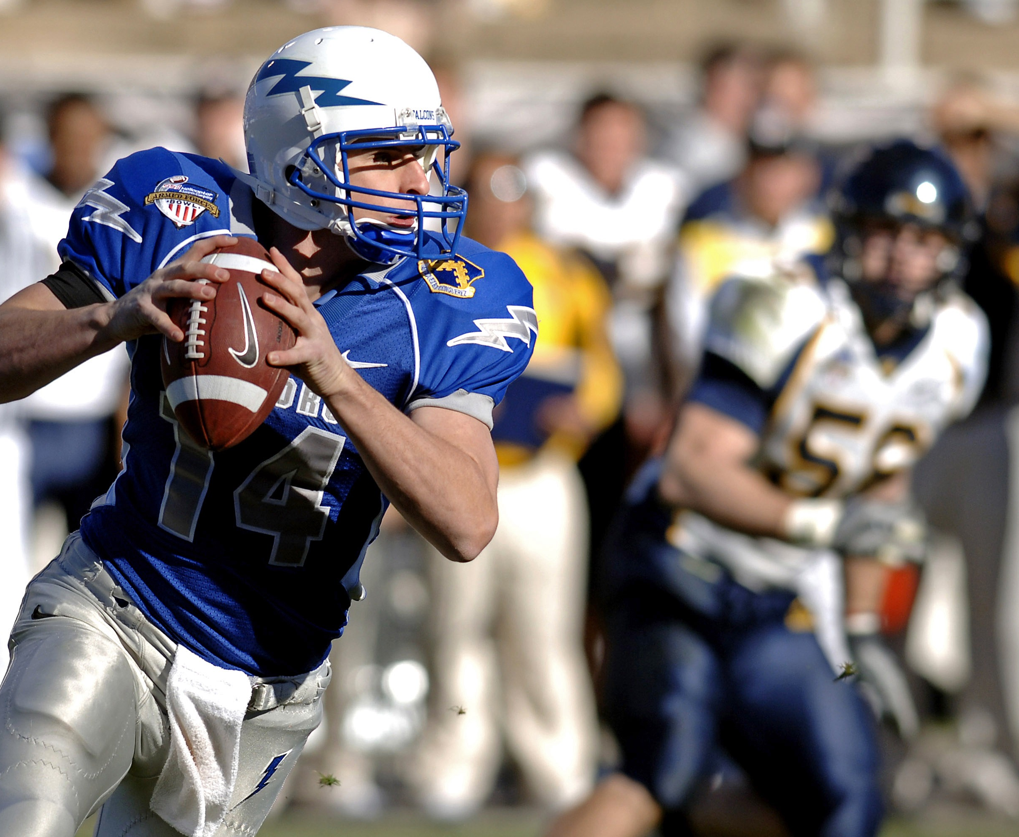
Football
2 Teams consist of 11 Players
Each player have Coaches – makes him the 12th
One Team – Offense
Another Team – Defense
Purpose of the Game: Move the ball to the Opposite end zones by running the ball or passing the ball
Whoever has the ball has 4 chances to move the ball and gain 10 yards.

Slide 12
”I will give you my very best..”
https://www.youtube.com/watch?v=Lqe1FT_9d4A

Slide 13
Teachings and Words of Encouragement
Rev. Federico Tito Mored, Jr.
This Photo by Unknown Author is licensed under CC BY-SA-NC

Slide 14
Recognition of a call to ministry
Bishop Rodolfo Asuncion – National Chairman
Rev. Stephen Etrata – Assistant National Vice Chairman
Rev. Loradel Salazar – National Secretary
Rev. Emily Santiago – National Treasurer
Rev. Alona Nesperos – Assistant National Treasurer
National Board of Directors:
Rev. Johning Nesperos
Rev. John Paul Salazar
Rev. Leonard Portales
Rev. Michael Baoas
Rev. Fernando La Pena
Rev. Ted Martinez
Rev. Lorna Enoch

Slide 15
ministry
Denotes the work of the whole Church, the body of Christ in the world.
Responsibility of the Church (Bride) in obedience to the commands of her Lord.
In the New Testament, - diakonia (“service, ministry”) and its related forms.
The diakonia word group, including also the verb diakoneō (“to serve, minister”)
and the noun diakonos (“servant, minister, deacon”),
Ministry is Incarnational (John 1:14)
Ministry is kerygmatic (Luke 4:18-19) (Isaiah 61:1-2)
Empowered by the Holy Spirit (Matt 3:16; Mark 1:10; Luke 3:22; John 1:32)
Humble Service (Mark 10:45; Luke 22:27)
Shepherding (John 10:1-18
Relational (Matthew 10-1-4; Mark 3:13-19; Luke 6: 12-16)

Slide 16
Induction of the 2022 National Officers – UCGMI - Philippines

Slide 17
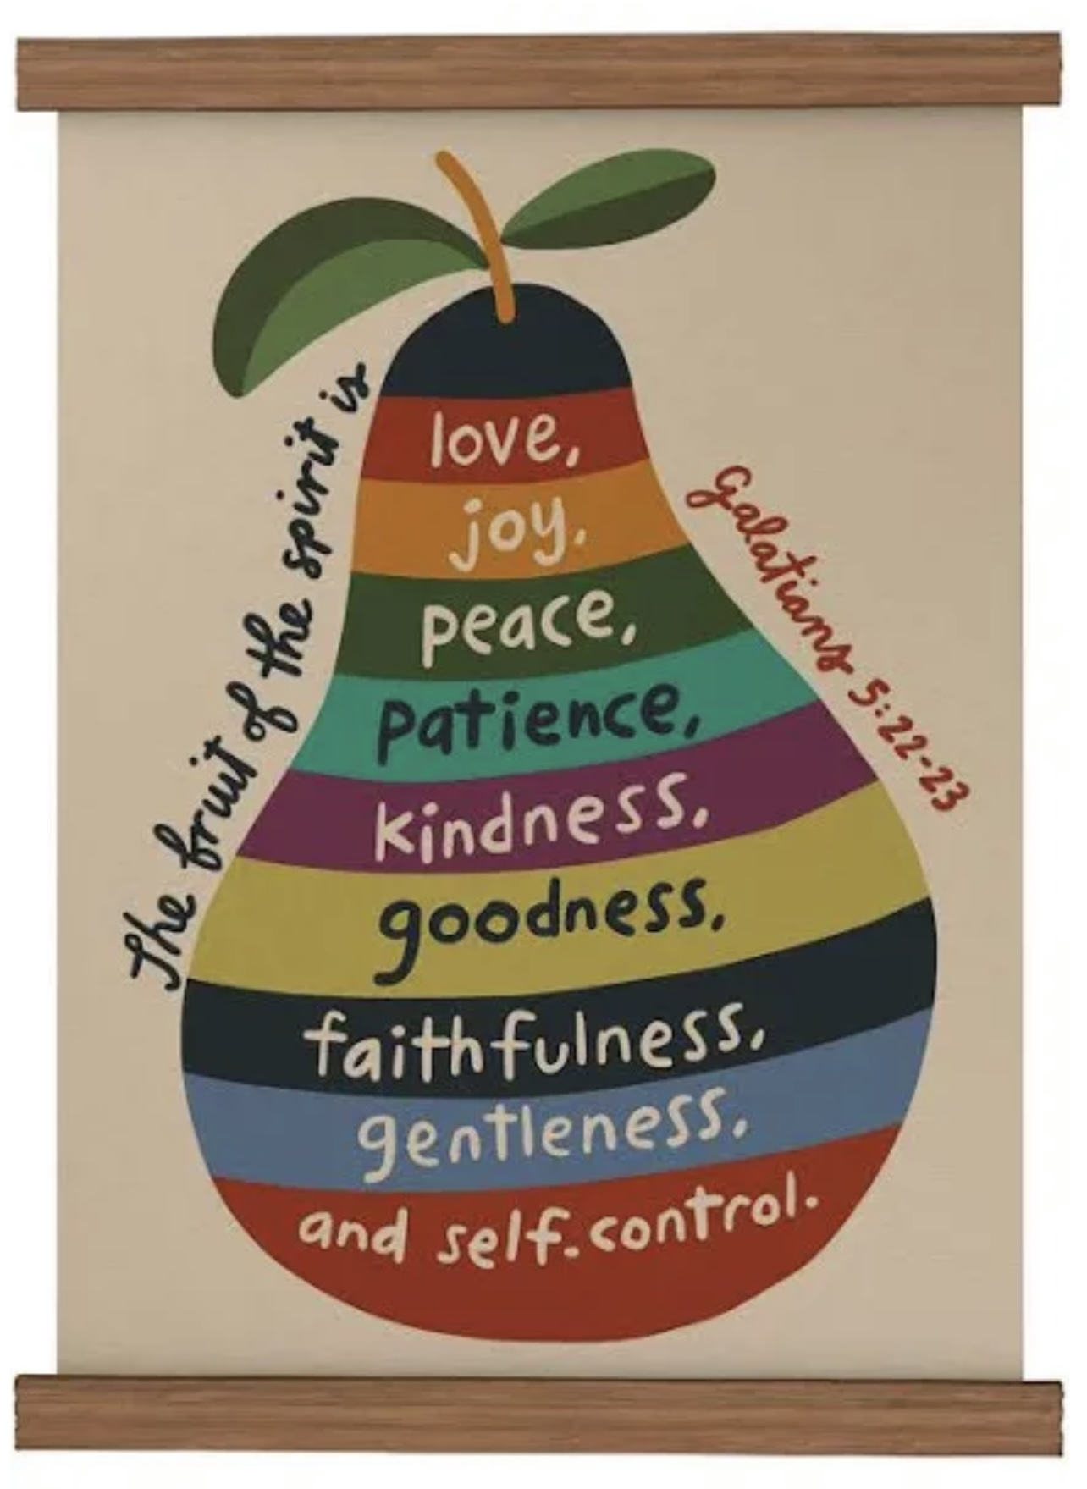
7 RESPONSIBILITIES AND PERSONAL ACCOUNTABILITIES
Study and Teach the FUNDAMENTAL TRUTHS/DOCTRINE OF THE BIBLE
Protect/Guard the PULPIT
Demonstrate the FRUIT OF THE SPIRIT
EVANGELISM at EVERY Opportunity
EXERCISE AND TEACH ABOUT GIVING
ESTABLISH an ACTIVE Prayer LIFE
BE Steadfast and BOLD
This Photo by Unknown Author is licensed under CC BY-ND

